Slide 1
Decision Dashboard for Urban Food Production
Week 3 Progress Update
Chiranjeevi Venkata Shiva Ruthvik Savaram, Y247K345, 9/30/2026

Slide 2
Tasks
Previous Week
This Week
Received CDC PLACES datasets from professor — Completed
Inspected structure, size, and data types of all 4 files — Completed
Checked missing values across datasets — Completed
Applied the Kansas City metro filter (14 counties, per OMB Bulletin No. 23-01) to the dataset — Completed
Confirmed the health variable shortlist against the reference document: Obesity, Diabetes, High Blood Pressure — Completed
Identified Demographic & Socioeconomic data (Census ACS) as the next category to pursue — Not Started
Decision Dashboard for Urban Food Production — Weekly Progress
2

Slide 3
Kansas City Metro Filter
14 counties (Missouri: 9 counties, Kansas: 5 counties)
County | Tracts
Jackson, MO | 195
Johnson, KS | 127
Wyandotte, KS | 64
Clay, MO | 44
Cass, MO | 20
Platte, MO | 19
Leavenworth, KS | 16
Miami, KS | 8
Lafayette, MO | 7
Bates, MO | 4
Ray, MO | 4
Clinton, MO | 4
Caldwell, MO | 2
Linn, KS | 2
County
Tracts
516
total tracts in the KC metro area
All 14 counties confirmed present in the filtered dataset.
Out of 72,337 tracts nationwide in the CDC PLACES tract file
Decision Dashboard for Urban Food Production — Weekly Progress
3
Notes:
https://www.whitehouse.gov/wp-content/uploads/2023/07/OMB-Bulletin-23-01.pdf – 14 counties(page 58) 28140 is code ID used for finding the section in the link
https://en.wikipedia.org/wiki/List_of_counties_in_Kansas – used for FIPS codes, Kansas state prefix = 20
https://en.wikipedia.org/wiki/List_of_counties_in_Missouri - used for FIPS codes, Missouri state prefix = 29

Slide 4
Health Variable Shortlist — Confirmed
Checked against the project reference document (Education & Health category, CDC PLACES source)
Variable | What it measures | Missing (of 516 tracts)
OBESITY_CrudePrev | Crude prevalence of obesity | 0
DIABETES_CrudePrev | Crude prevalence of diagnosed diabetes | 0
BPHIGH_CrudePrev | Crude prevalence of high blood pressure | 0
Variable
What it measures
Missing
These are the only three health measures selected as they are more common health conditions — not the full CDC PLACES health-measure list (which also includes healthcare access, screenings, and others we are not using). All three are fully populated across the 516-tract KC metro subset, so no missing-value handling is needed for this category.
Decision Dashboard for Urban Food Production — Weekly Progress
4
Notes:
Obesity, diabetes, high blood pressure, arthritis, asthma, healthcare access, cancer screenings, smoking, mental health etc. . The full list has 40+ columns

Slide 5
Project Variable Framework
All four criteria categories named in the reference document, and where each stands
Category | Example Variables | Source | Status
Education & Health | % below HS graduation; Obesity, Diabetes, High Blood Pressure | Census ACS + CDC PLACES | Health measures confirmed (3/3); education variable pending
Demographic & Socioeconomic | Pop. density, % Black/Hispanic, % foreign-born, % 65+, % no vehicle, % renter-occupied | Census Decennial / ACS | Not started
Economic | Median income, median rent/home value, % poverty, % SNAP, employment rate | Census ACS, USDA ERS, BLS | Not started
Built Environment / Access | Distance to food store, % transit access, % vacant land | ArcGIS + parcel data (ORKA/KCMO) | Not started
Category
Example Variables
Source
Status
This week's work confirmed the health measures. Next step is to confirm the approach for the Demographic & Socioeconomic category before sourcing ACS data.
Decision Dashboard for Urban Food Production — Weekly Progress
5

Slide 6
Next Week Plans (10/7/2026)
Activities/Tasks
Find the right Census ACS data for demographic and socioeconomic variables
Select and collect the needed ACS variables for the KC metro tracts
Add the ACS data to the current health dataset
Expected Outcomes
Selected ACS variables
ACS data for the 516 KC metro tracts
Updated dataset combining health and demographic/socioeconomic data
Deliverable
Updated KC metro dataset with the initial Demographic & Socioeconomic variables
Progress presentation
Decision Dashboard for Urban Food Production — Weekly Progress
6

Slide 7
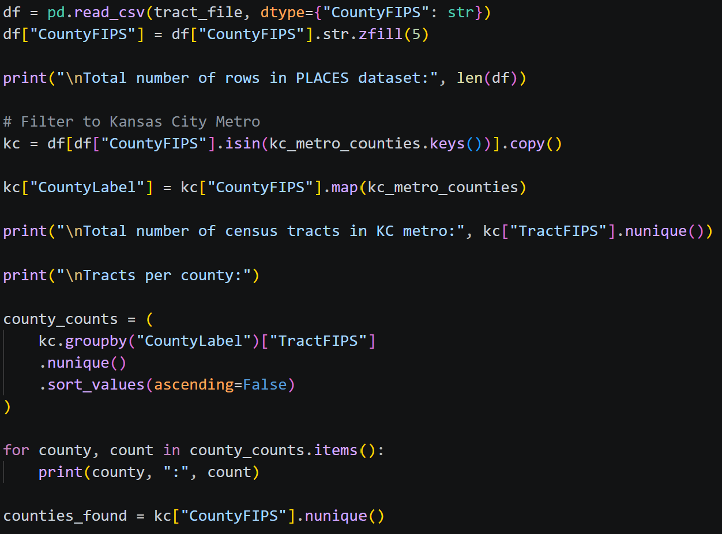
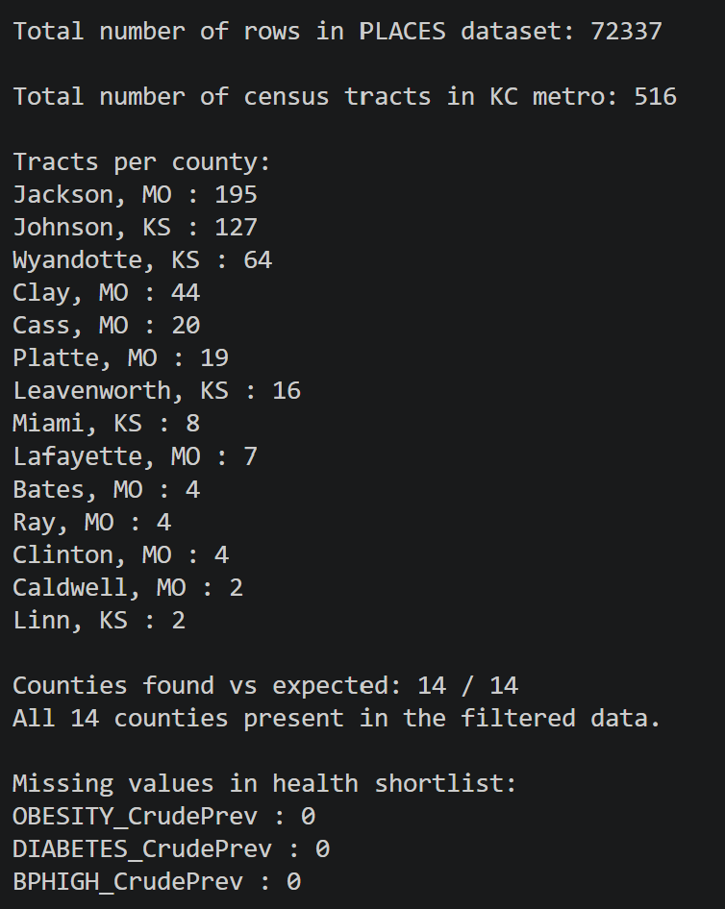
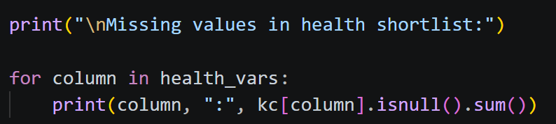
Appendix — KC Metro Filter Code
Decision Dashboard for Urban Food Production — Weekly Progress
7

